Slide 1
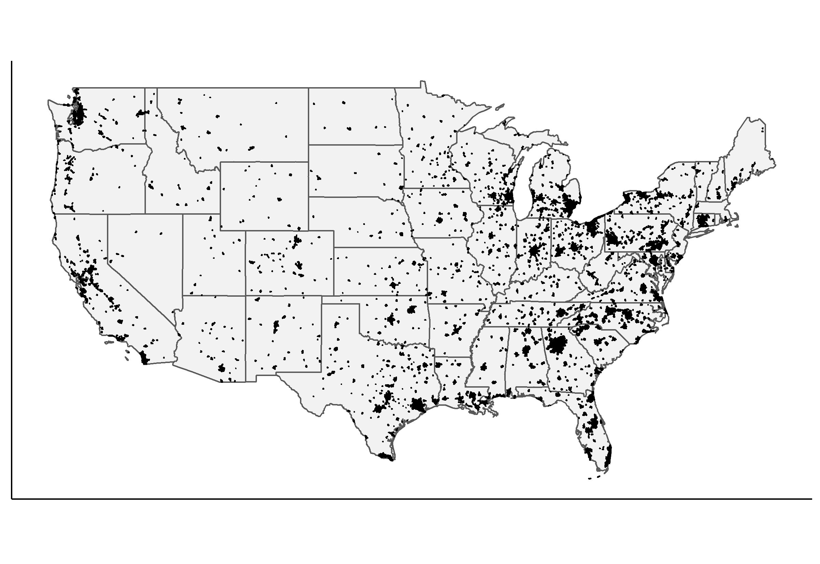
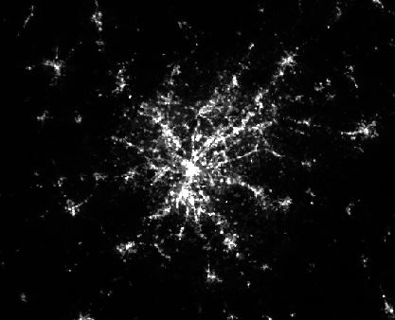
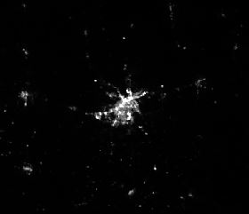
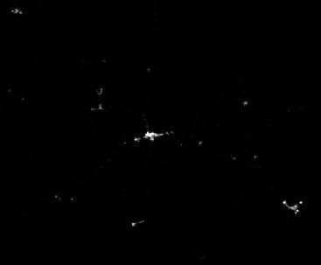
a)
1,581 cities included in the analysis
b)
Atlanta, GA (291.0; 15.90; 8.98)
Shreveport, LA (242.0; 22.70; 15.45)
Gallup, NM (113.0; 26.6; 20.70)

Slide 2
b)
Atlanta, GA
a)
Shreveport, LA
Gallup, NM

Slide 3
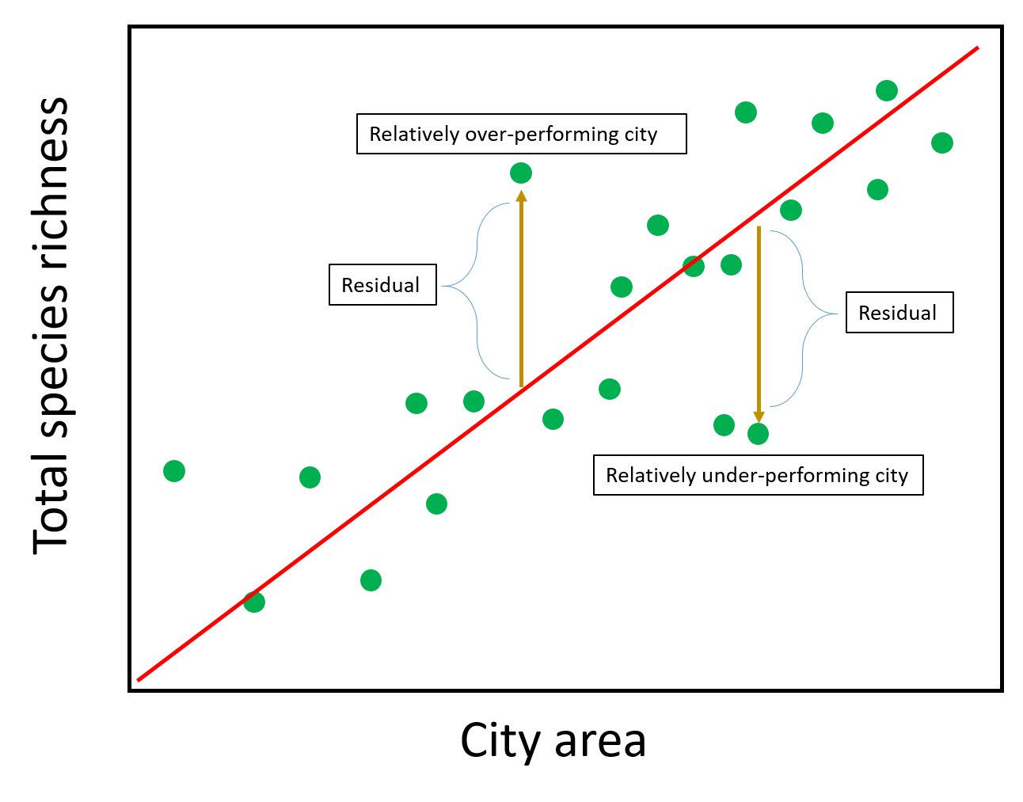
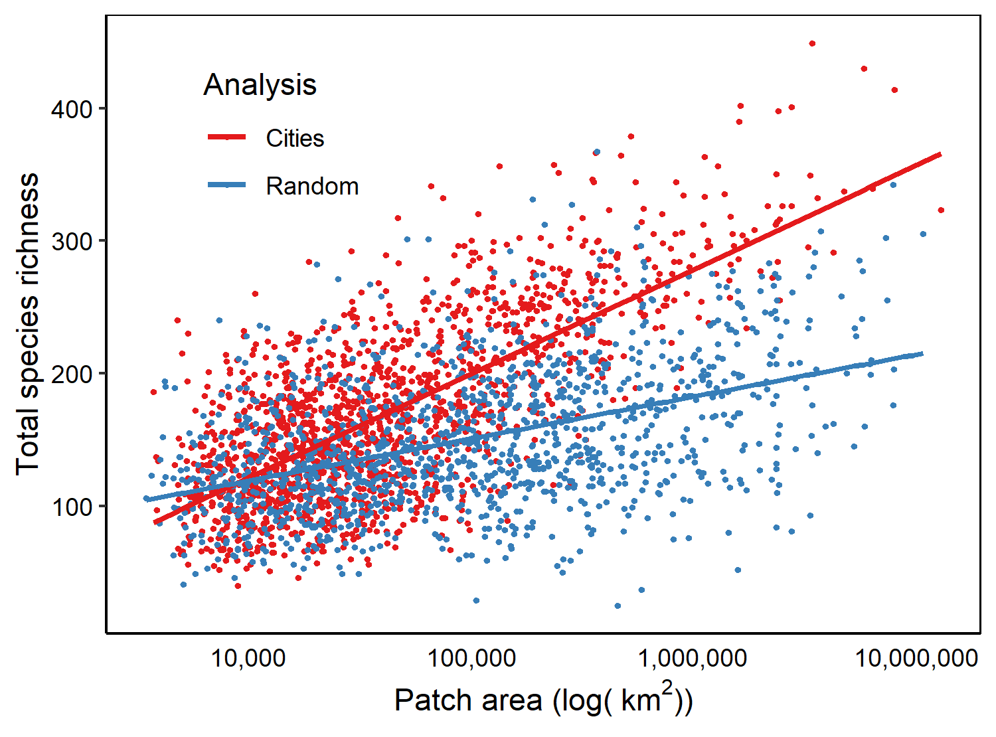
a)
b)

Slide 4
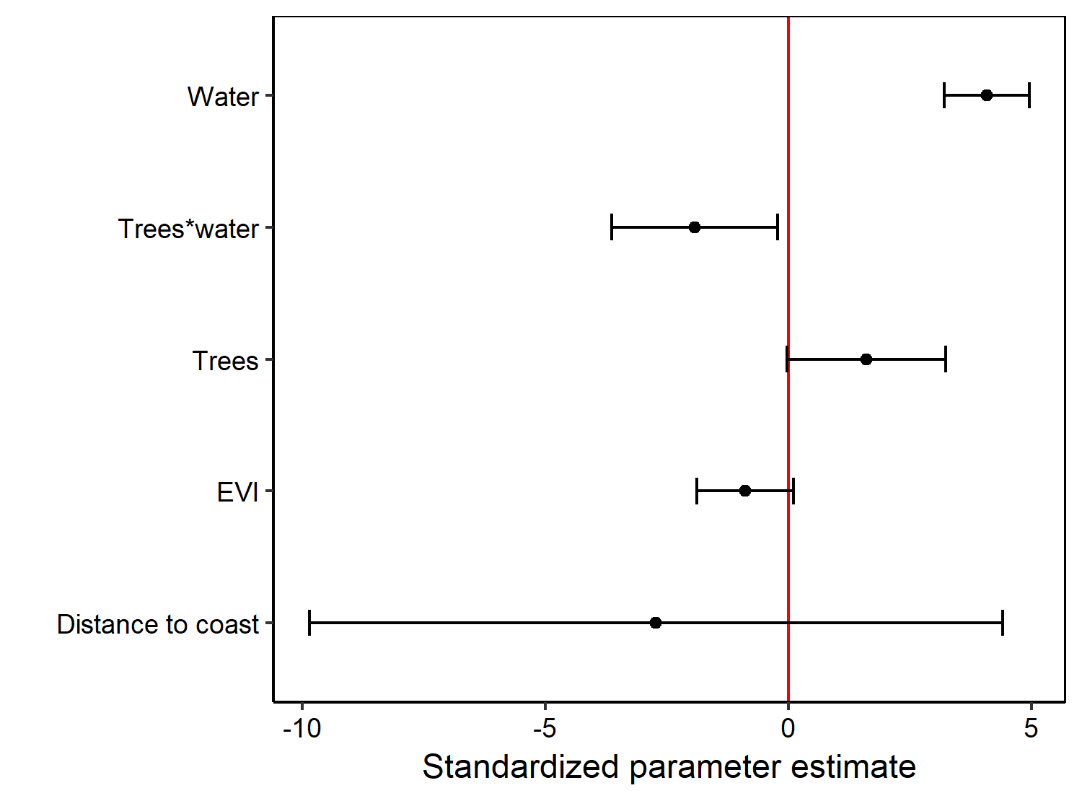
< than expected species richness
> than expected species richness

